Slide 1
JPEG PLENO
‘Can JPEG again revolutionize the world of imaging?’
Touradj Ebrahimi
JPEG Convener

Slide 2










JPEG Family of Standards

Slide 3
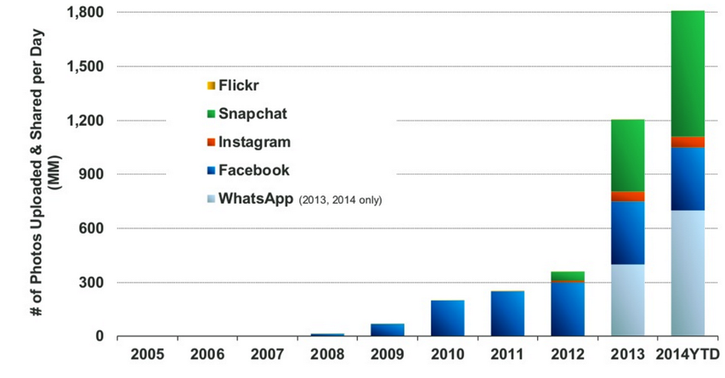

JPEG a strong and fast growing ecosystem
1995-96 Technology and Engineering
Emmy award (together with MPEG-2)
Source: KPCB 2014 Internet Trends, estimates based on publicly disclosed company data.

Slide 4
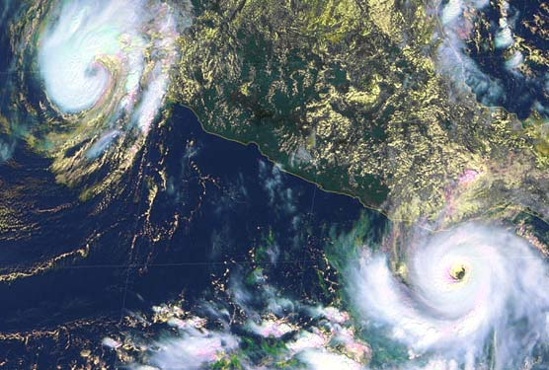

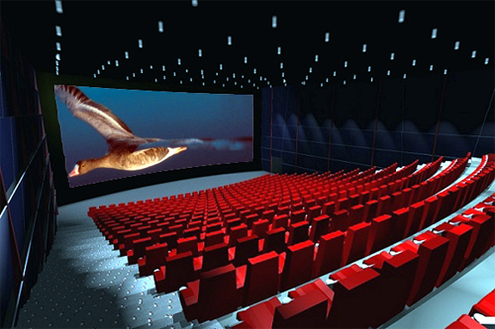

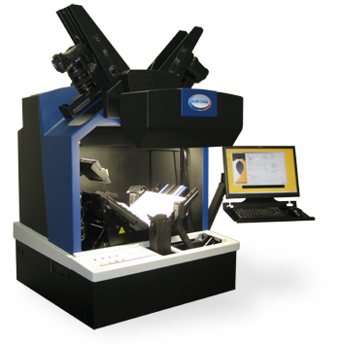


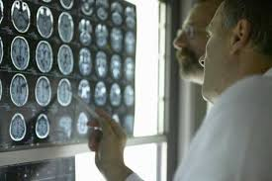
JPEG 2000 great impact on professional markets
2015 Technology and Engineering
Emmy award (JPEG 2000 interoperability)

Slide 5
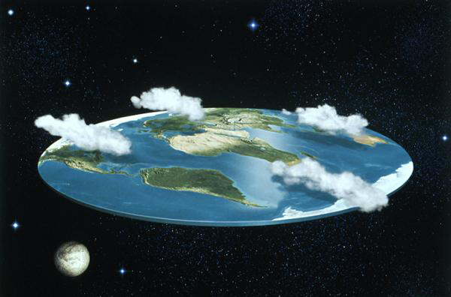
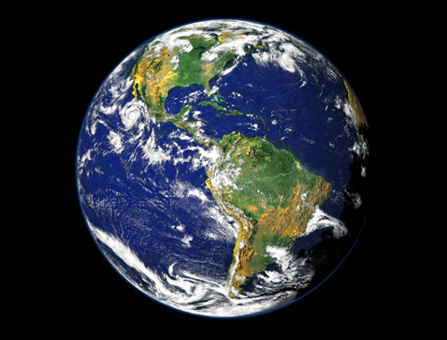
Should pictures be flat?

Slide 6
Plenoptic representation of visual information
7D function P(a,q,l,t,x,y,z)
  view point
  wavelength
  time

Slide 7
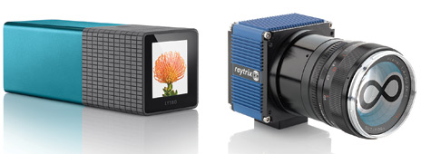
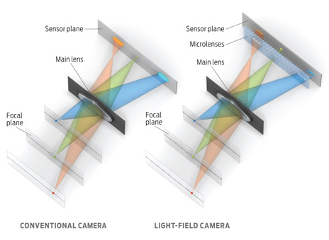
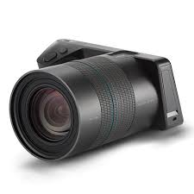
Light-field Photography

Slide 8


Point-cloud Photography

Slide 9

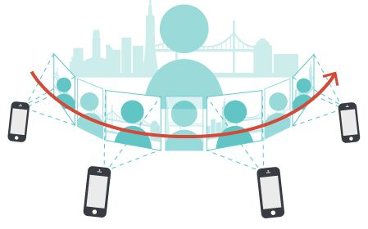

Spatial Photography
Motion parallax

Slide 10
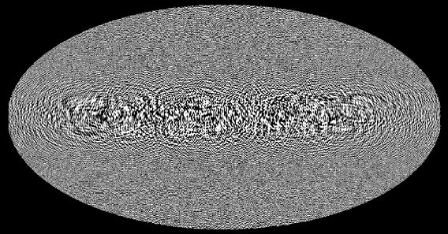

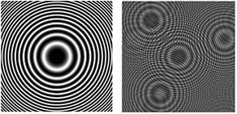
Holographic Photography
HOLOGRAM
Interference = superposition of waves
LIGHT-FIELD
Rays with position + orientation

Slide 11
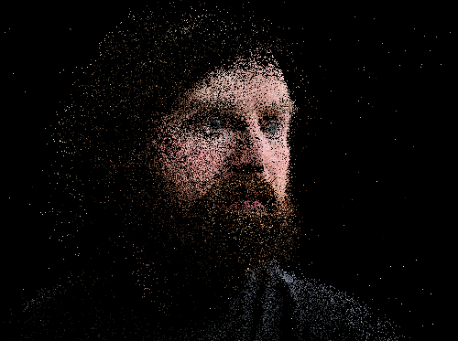

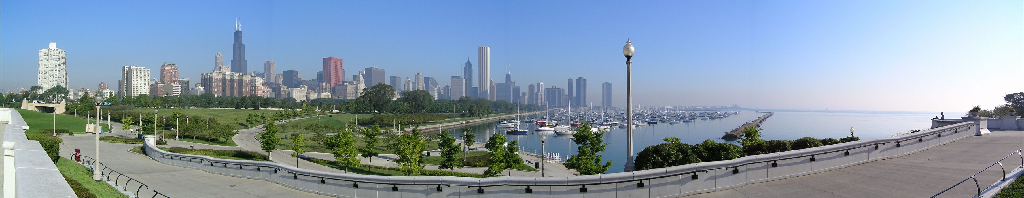
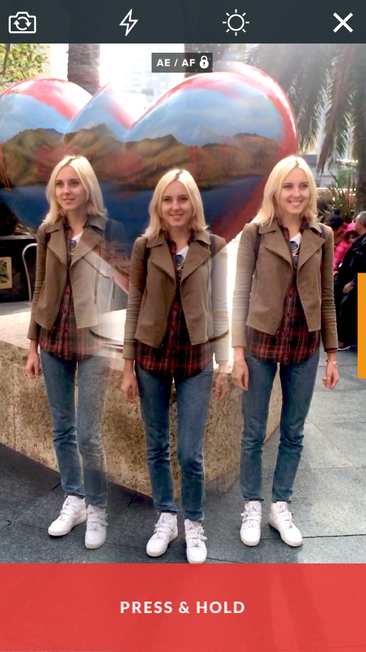

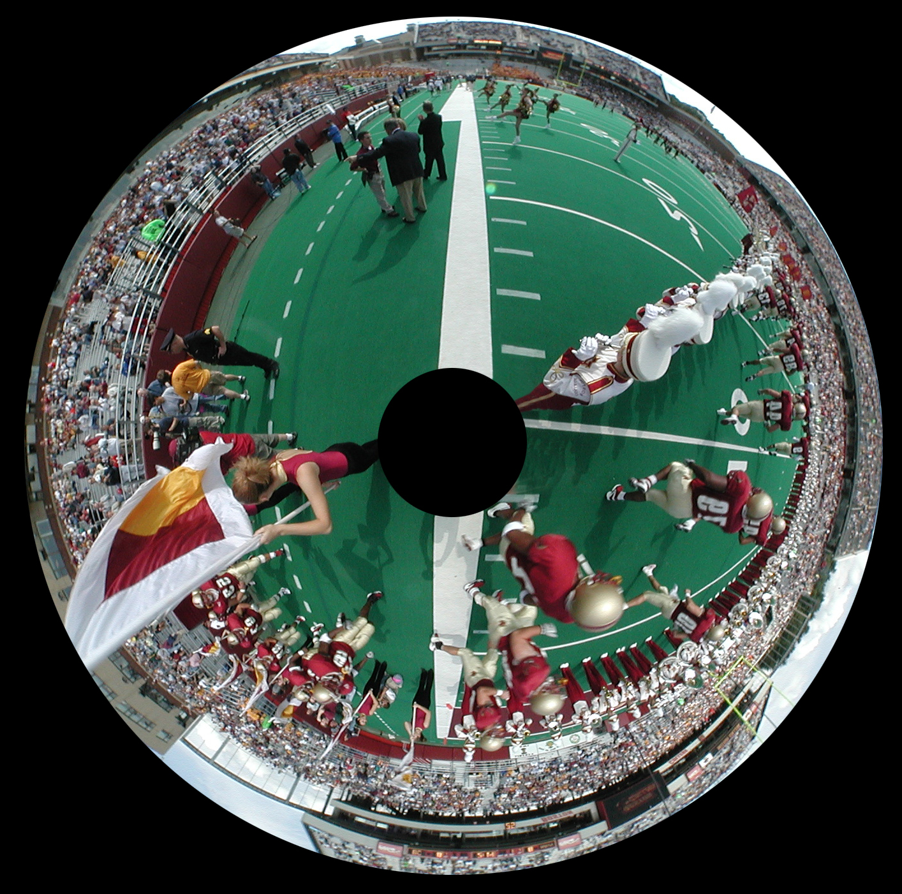
JPEG PLENO design principles
One or limited number of representation models
Well defined, specific and useful milestones
Backward compatible with legacy JPEG
Panorama
Light field
Spatial photo
Point cloud
360 degree
Holography

Slide 12
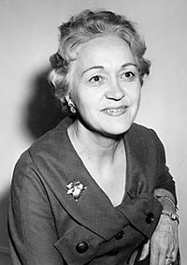
Looking forward to an exciting workshop
The World is round and the place which may seem like the end may also be the beginning.
Ivy Baker Priest

